Slide 1
NFL First Down Analysis
when should we attempt a pass or decide to run the ball to get a first down?

Slide 2
What is our main goal?
We are looking to use NFL play-by-play data to decide when we should pass the ball or run the ball when trying to get a first down.
Will be looking to see if passing and running plays result in a first down.
We will be using various predictors that will be discussed along with various regression models to best fit our data.

Slide 3
Guidelines to Analysis
Using data from the 2018 to 2023 NFL season.
We will filter our data between passing and running plays. This means we will not be looking at punts, field goals, or defensive turnovers.
Our response variable will be First Down, meaning if the play resulted in a first down or not.
We will be using the 2018, 2020 and 2021 season data as our training data for our models.
We will be using the 2019, 2021 and 2023 season data as our test data to test fitted models on training data.
You will find the predictors that we chose to use for our analysis on the next slide.

Slide 4
Predictors Used for Analysis
Season
2018-2023
Down
First Down
Second Down
Third Down
Fourth Down
Yards to Go
Distance to the first down marker
Field position of play (0 to 100, 50 being midfield)
Temperature
Wind

Slide 5
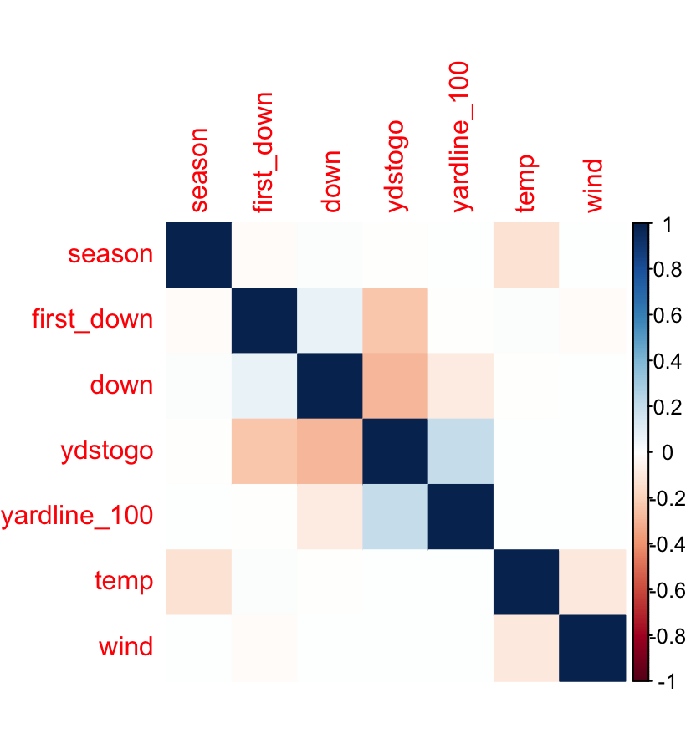
Passing Data Predictors
Yards to go has negative impact on obtaining a first down
This make sense. Longer you are from the sticks, harder it is to get a first down.
The yards to go is negatively impacted by what down it is
This also makes sense as the down increases, ideally your yards to go become smaller
The down is a slight positive correlation to getting a first down as well

Slide 6
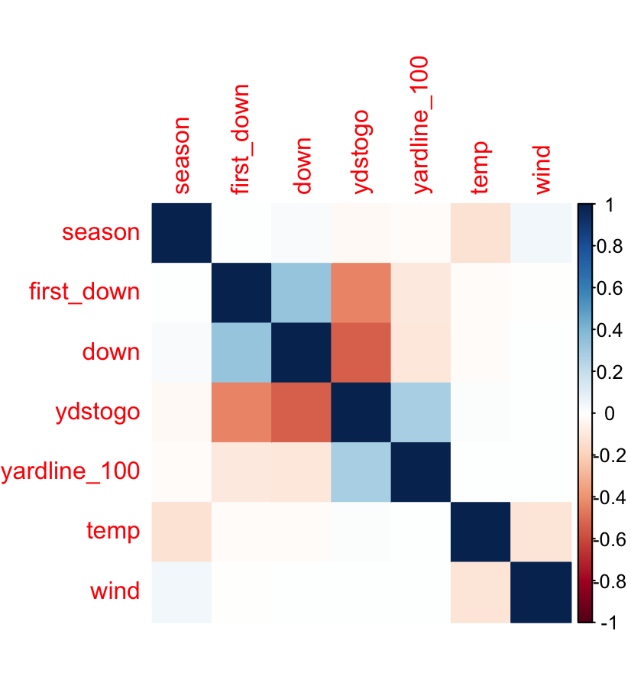
Running Data Predictors
Very similar scenario with running data
If anything, the predictors have more of an impact on the first down predictor than when we pass the ball
Now we can talk about what model selection we chose

Slide 7
Model Selection
Model Walkthrough
Used training data (passing/running plays from 2018, 2020 and 2022 seasons) to train regression models.
Used trained regression models to predict if a play ended in a first down or not on our test data (passing/running plays from 2019, 2021 and 2023 seasons).
After fitting multiple models, we found that a K-nearest neighbor model where K = 3 was the best model at predicting whether or not a play would end in a first down for both passing and running plays.
This just means that when we predicted if a play was either a first down or not, our model used the three closest data points and their predictor values (down, yards to go, field position, etc.) to help make that prediction.

Slide 8
Prediction Rates by Plays
PASSING PLAYS:
Of our 60,111 plays in our test passing data, we were able to predict if a play was either a first down or a not a first down 87.5% of the time.
Within this model, we were able to predict that a first down play was going to occur 84.5% of the time.
RUNNING PLAYS:
Of our 43,058 plays in our test running data, we wer able to predict if a play was either a first down or not a first down 90.6% of the time.
Within this model, we were able to predict that a first down play was going to occur 86.1% of the time.

Slide 9
Game Scenarios and what are model says to do
Now we can look at some scenarios based on down and distance and what our field positions is.
We are doing these assumptions assuming that we are either looking to pass or run the ball.
Therefore, we are not considering punting or kicking a field goal.
We trained the K-nearest model using the parameters we will be looking at to help us make our predictions.
Our recommendations were ,made based on overall prediction rate and ability to predict first downs.

Slide 10
Game Scenarios
Outside of Red Zone:
3rd and short (3 or less yards to go): PASS or RUN. Our model had same prediction rate for both passing and running the when it came to predicting first down under these conditions.
3rd and long (7 or more yards to go): PASS
4th and short (3 or less yards to go): RUN
4th and long (7 or more yards to go): PASS
Inside the Red Zone (20-yard line to 3-yard line):
3rd and short (3 or less yards to go): RUN
3rd and long (7 or more yards to go): PASS
4th and short (3 or less yards to go): RUN
4th and long (7 or more yards to go): PASS

Slide 11
Game Scenarios Continued
Goal Line to Go (between the 3-yard line and the goal line)
The data between the 2018 and 2023 seasons that I was working with did not have enough data for me to analyze this situation.
However, assuming we are not looking to kick a field goal in this situation, I would use my red zone recommendations in this scenario as well
3rd and goal: RUN
4th and goal: RUN

Slide 12
Analysis Conclusion
Based on the data that we had, we were able to fit a K-nearest neighbor model using K = 3 (meaning we used three closest data points when predicting a test observation).
We were able to use our model to help us decide how well we can predict first down percentages based on down, yards to go to get the first down, and field position (whether we were outside of the red zone or in it).
We needed more data to help us analyze what to do in goal to go situations. However, we used our red zone predictions to help with that.

Slide 13
Analysis Conclusion Continued
This model that we fit to the data is intended to help the coaches make the right call for the team when faced with a certain down and distance.
Therefore, when it comes to either running or passing the ball to get a first down, we have model to help make the most informed decision possible.
Rather than deciding whether to pass or run, the model will recommend which one to do so you can focus on your most effective pass/run play call and formation.
This model helps you make one less decision during during the 25-40 seconds in between each play.

